Slide 1



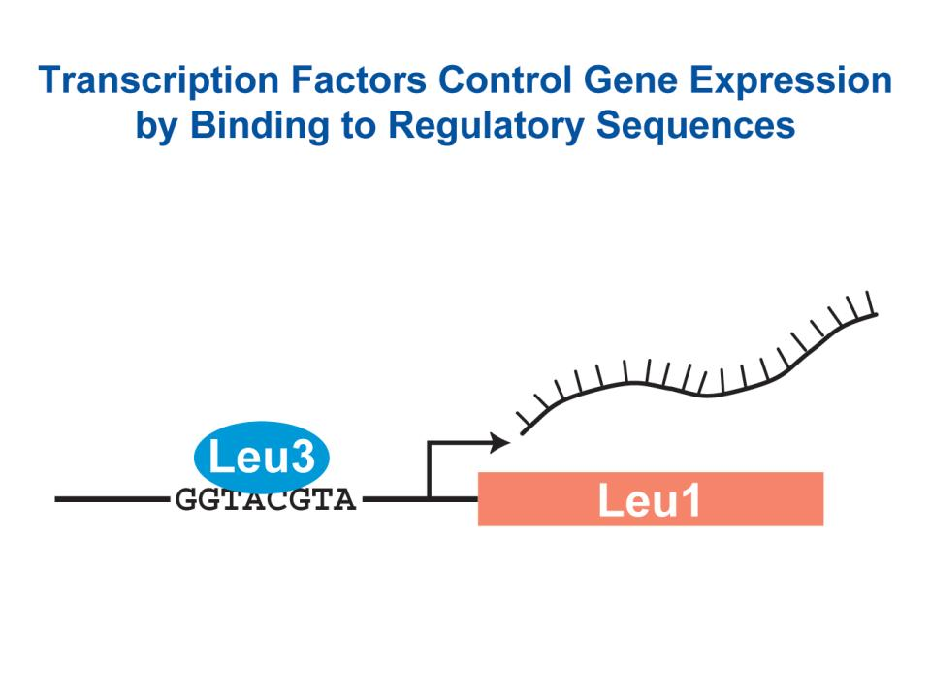
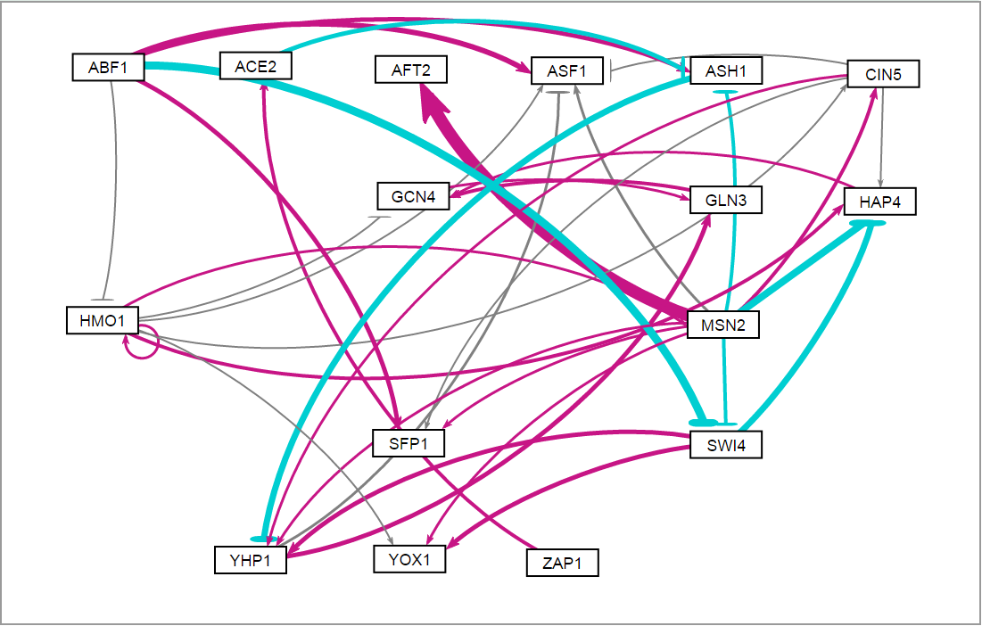
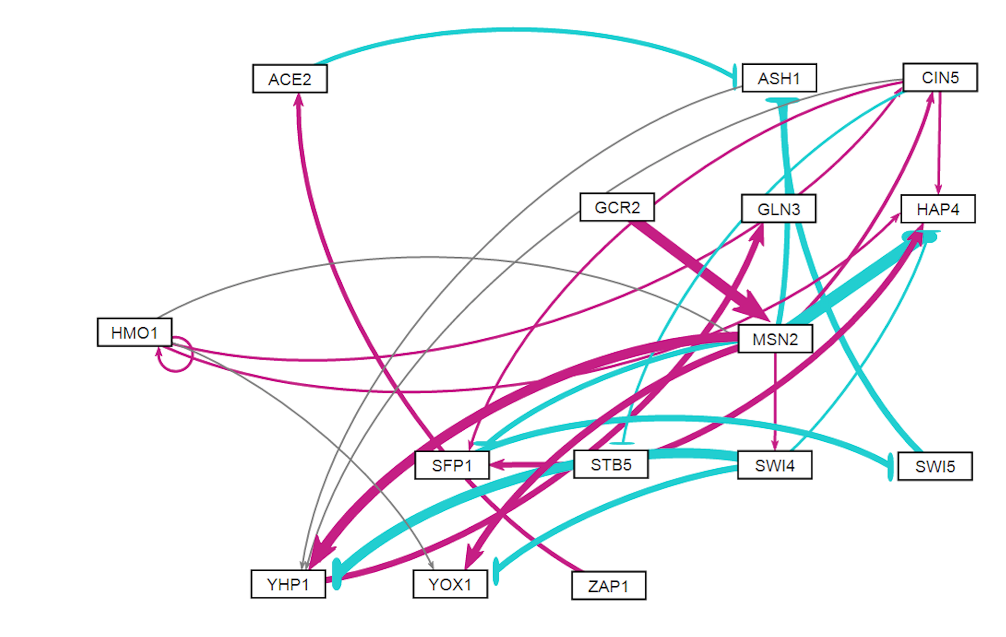
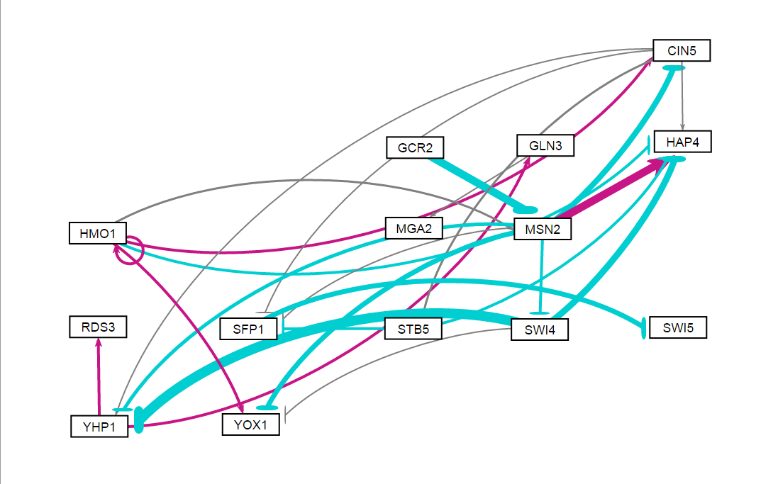
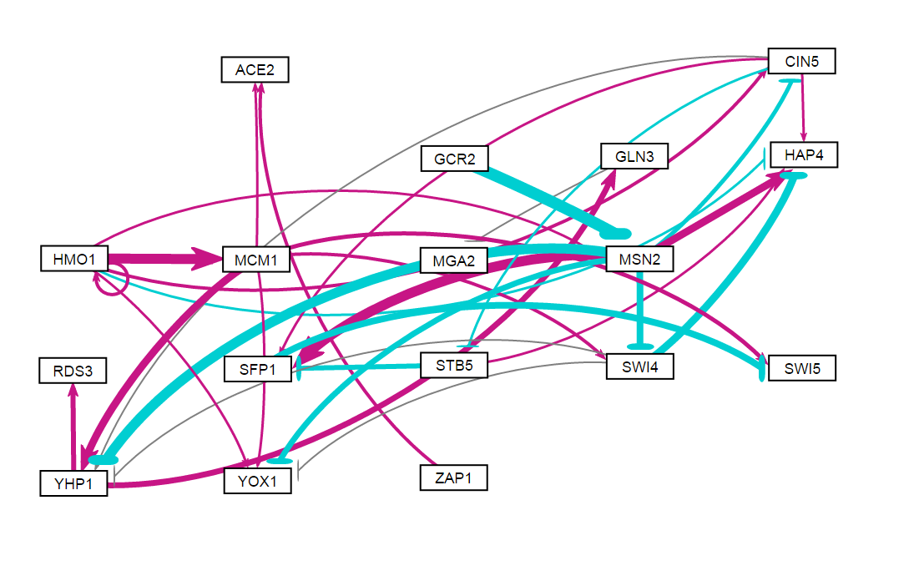
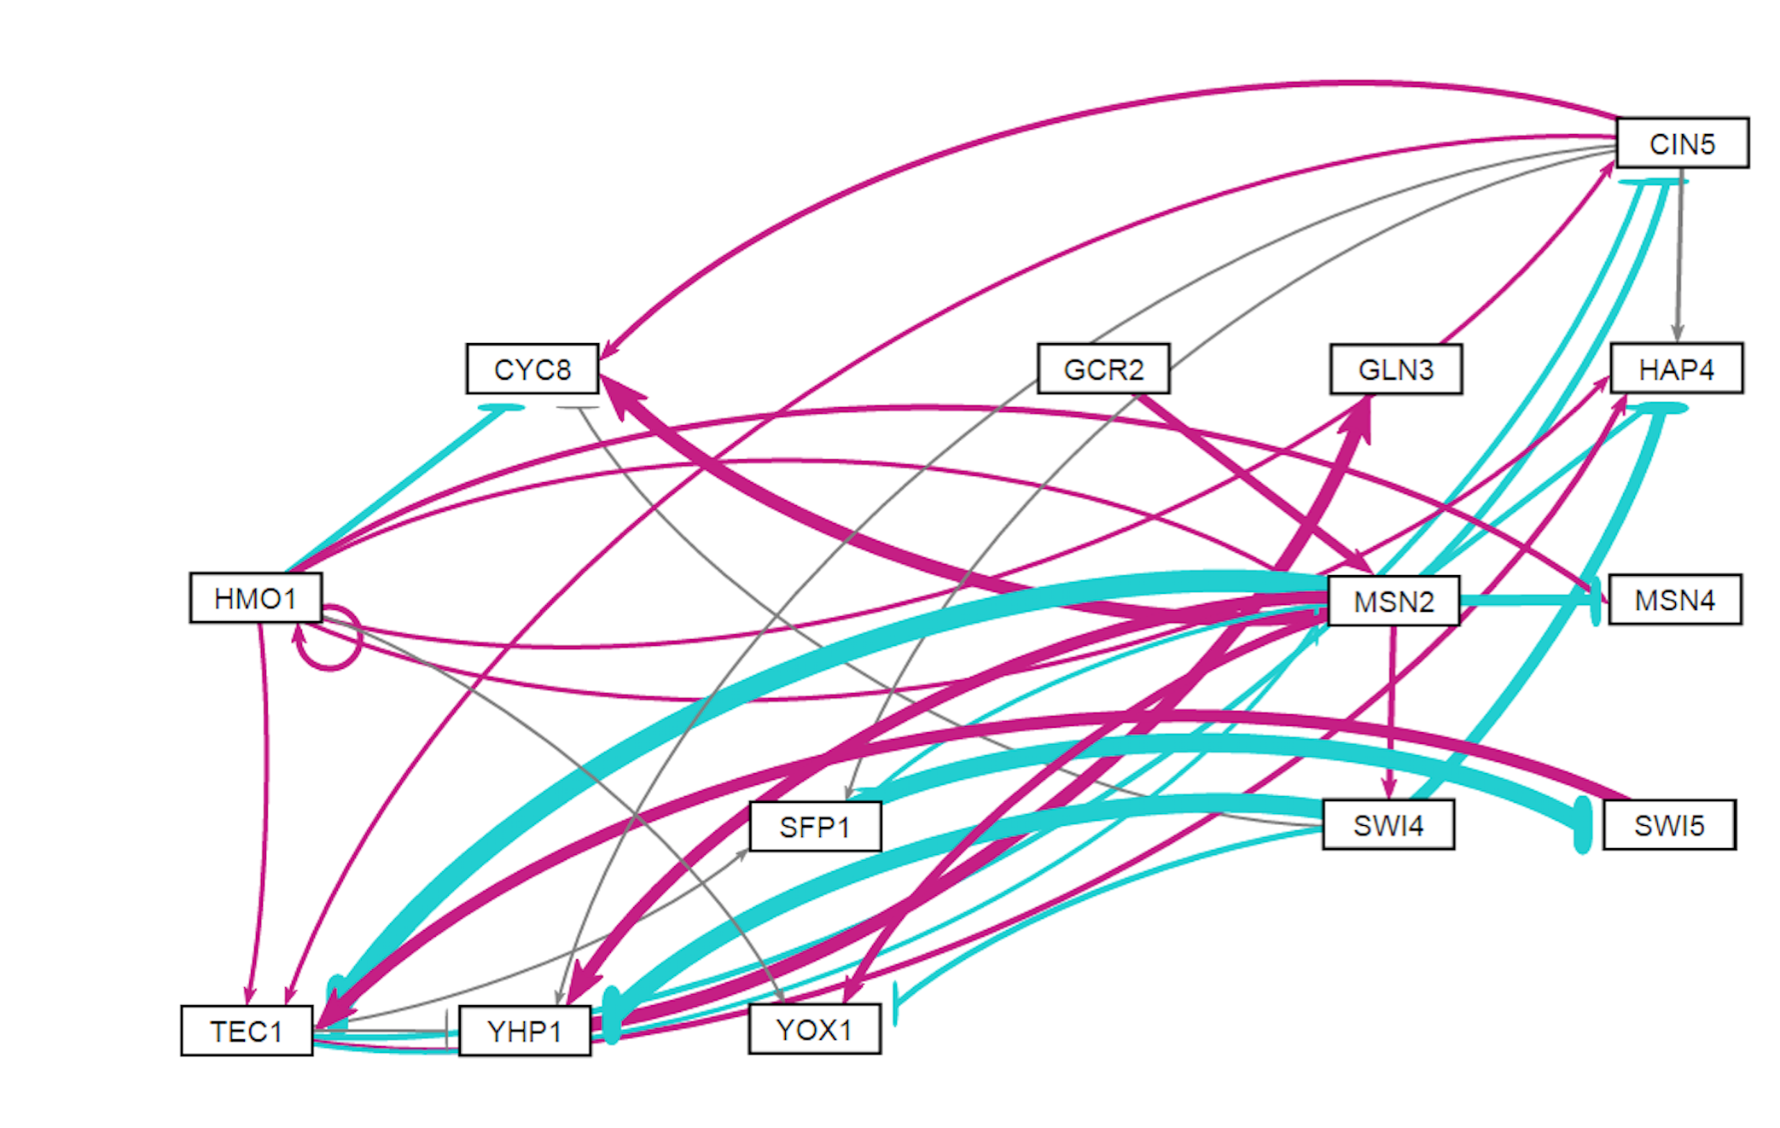
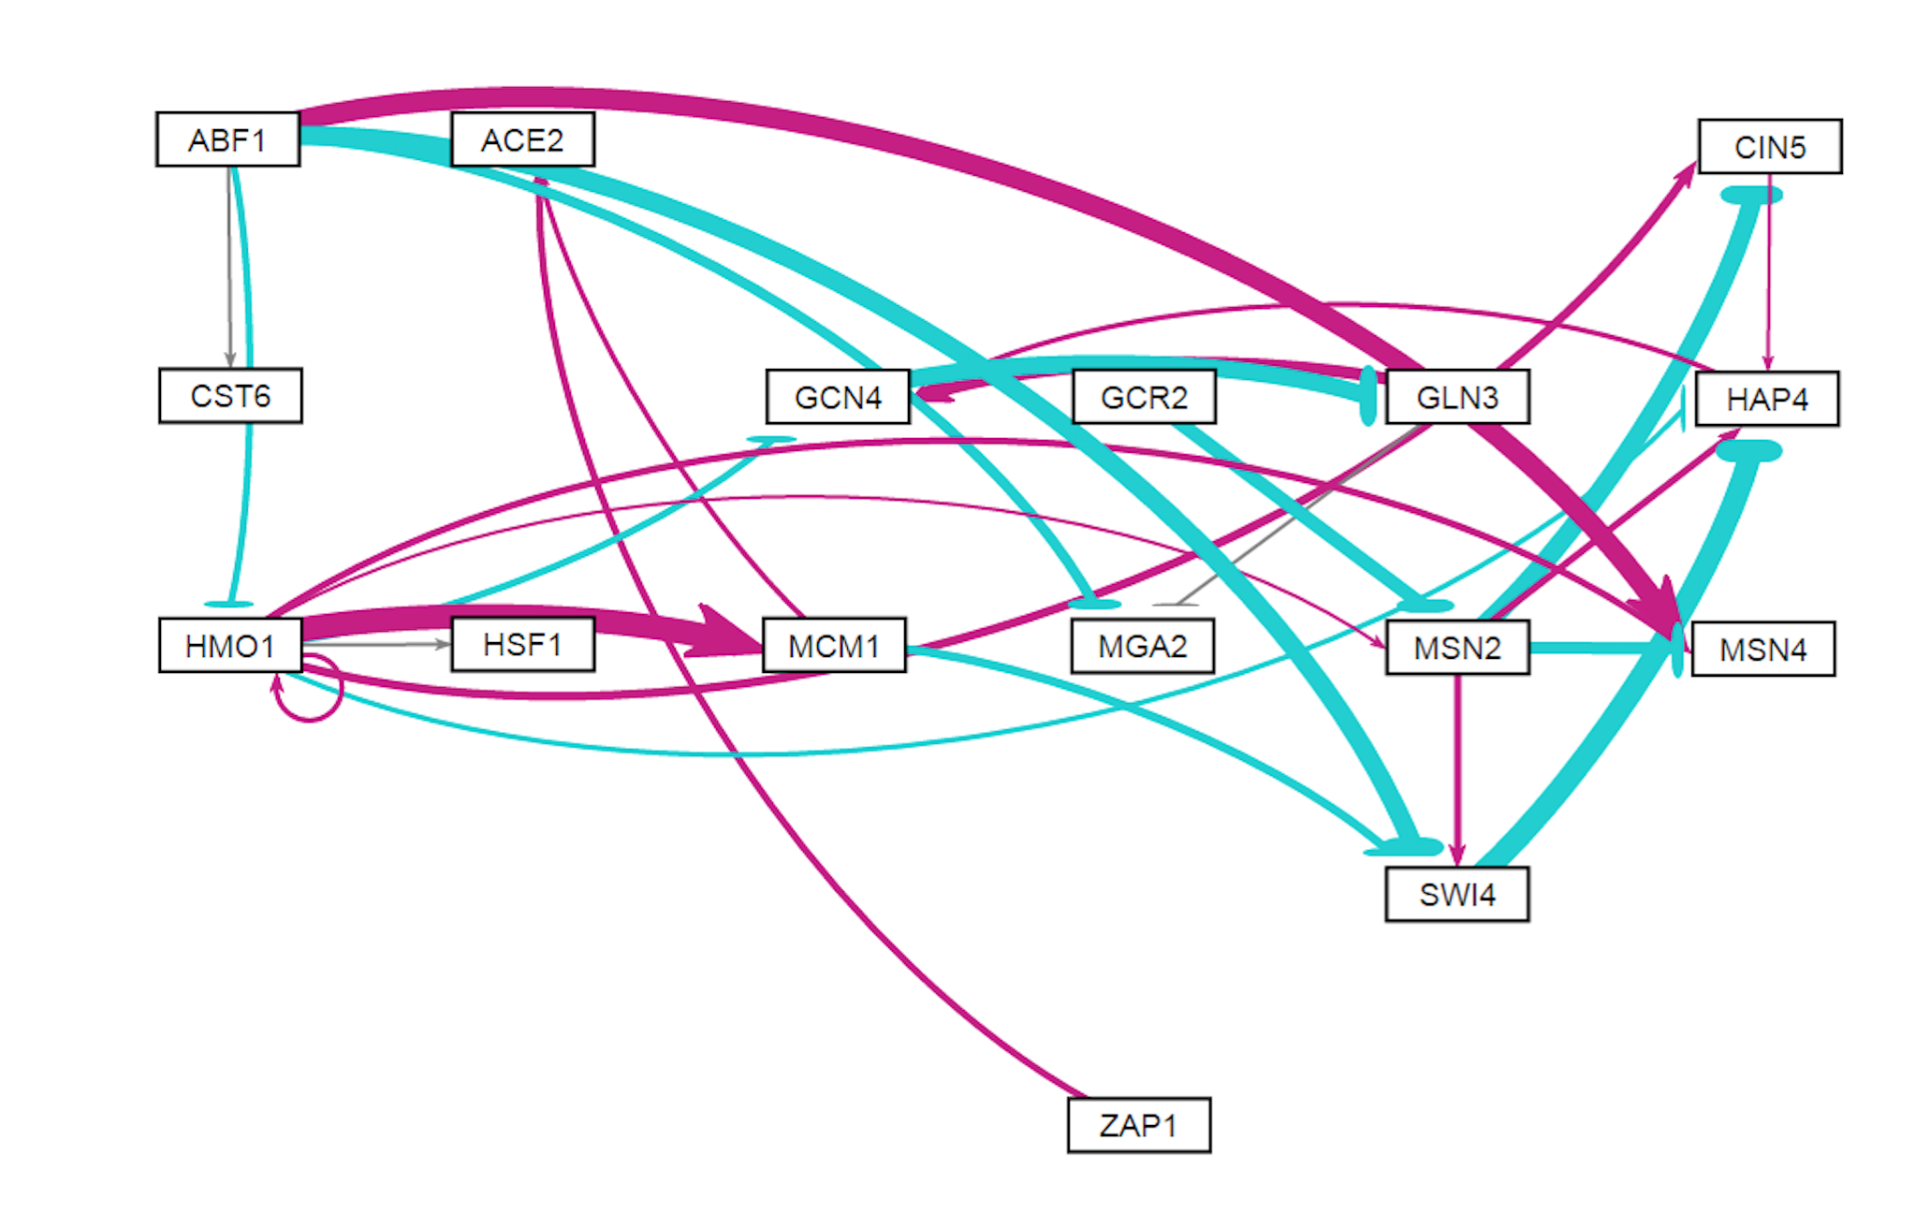
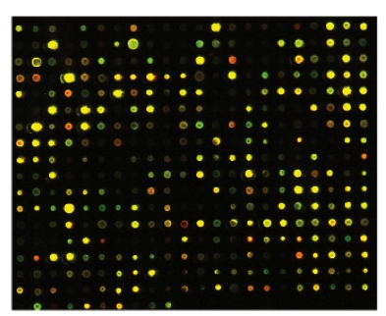
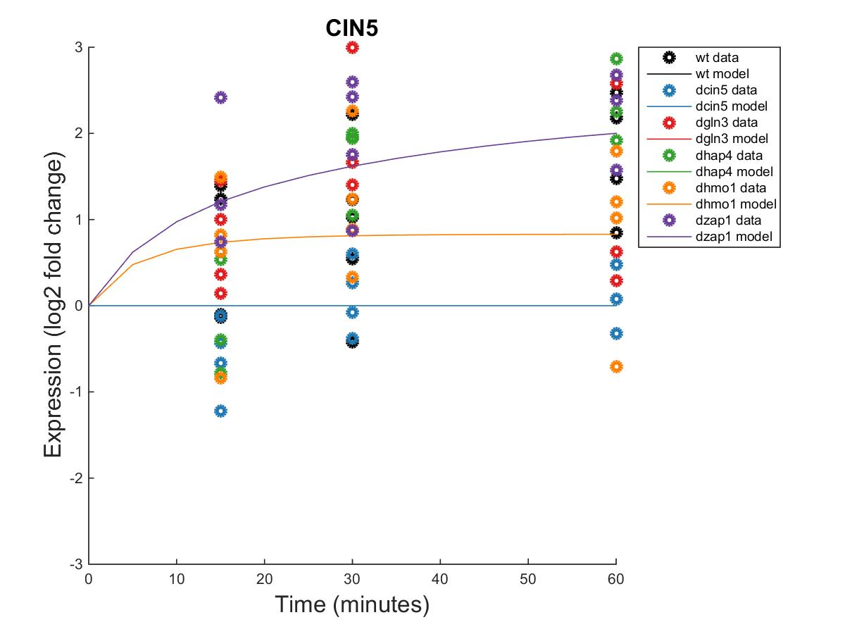
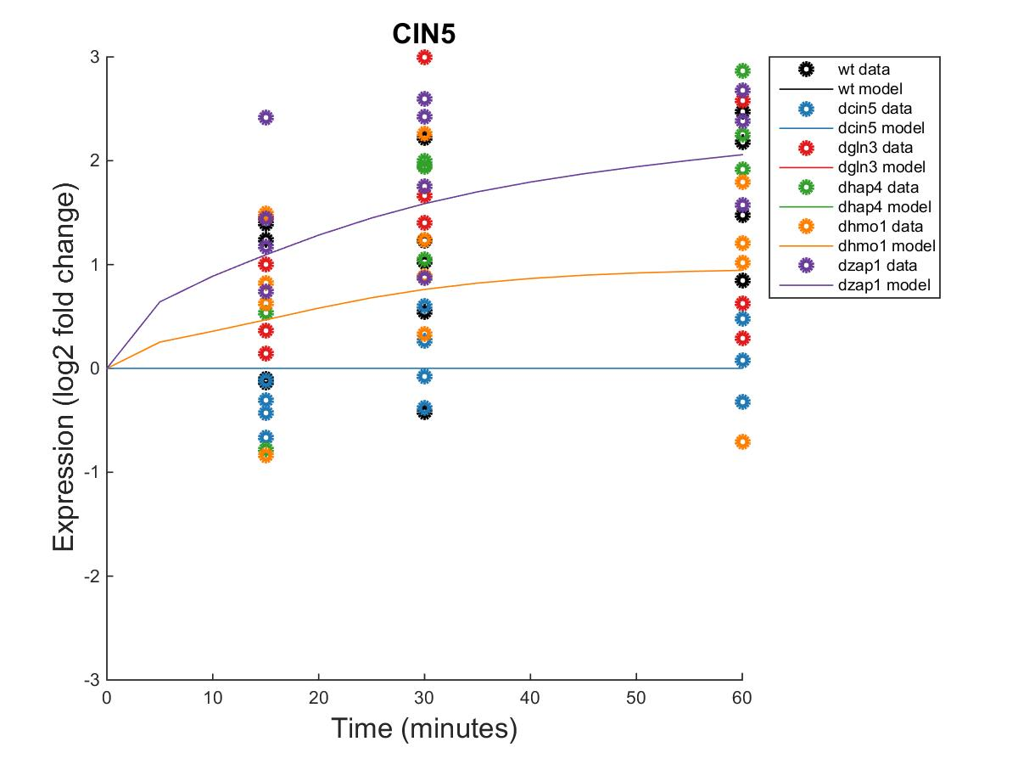
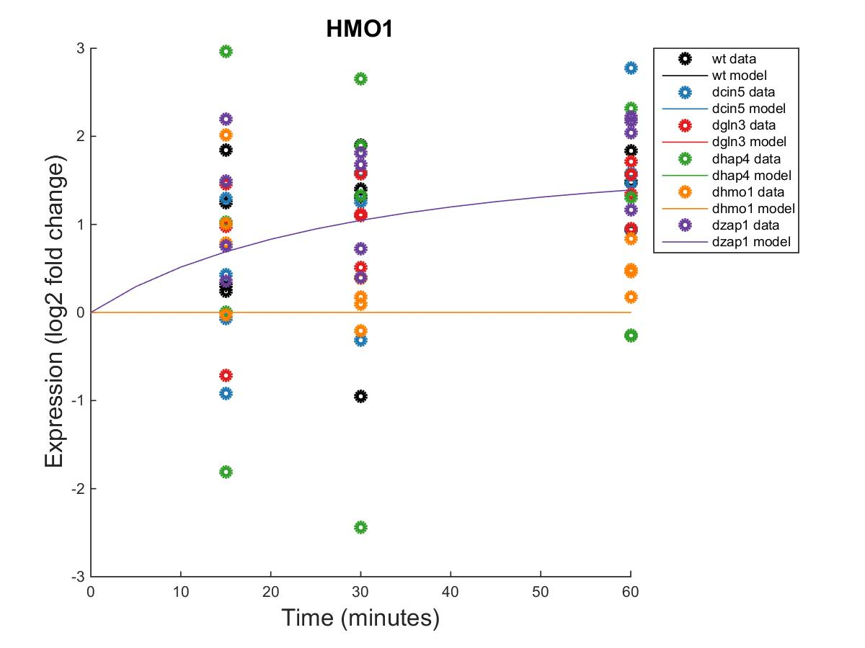
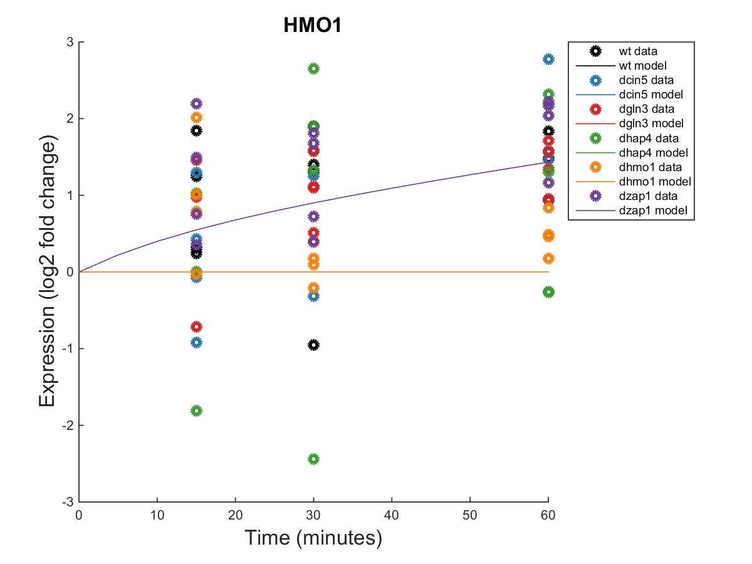
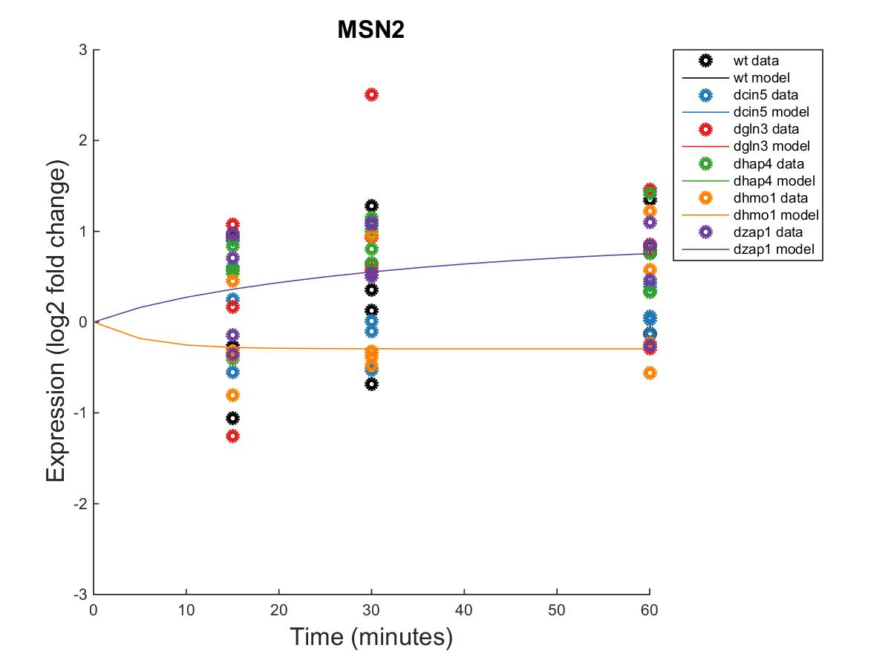
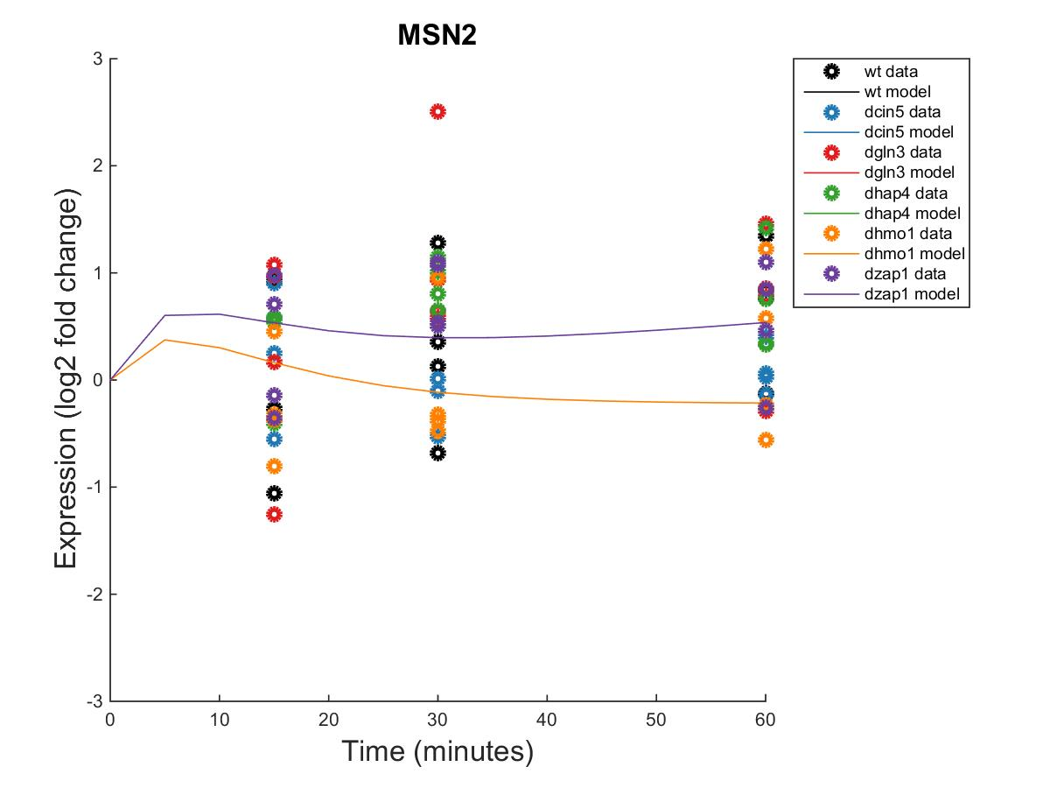
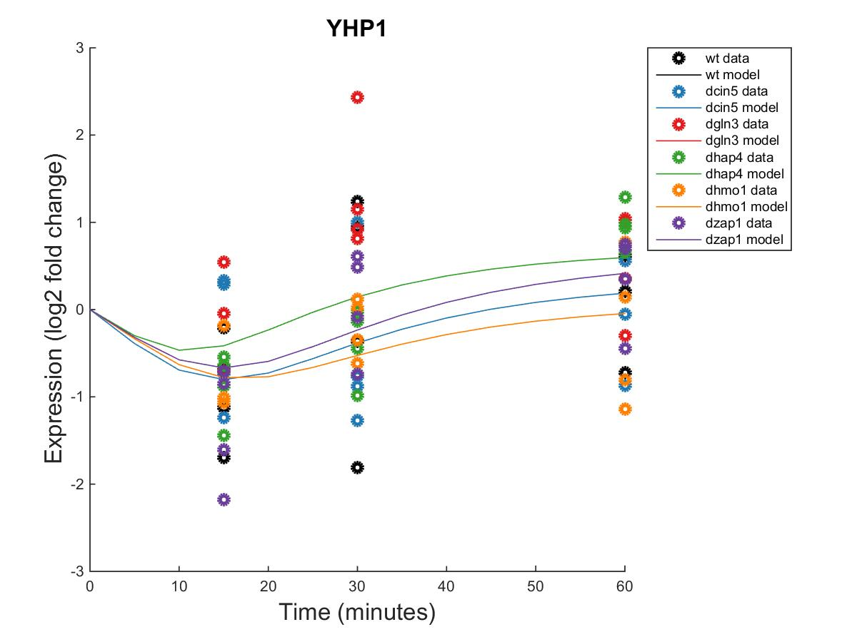
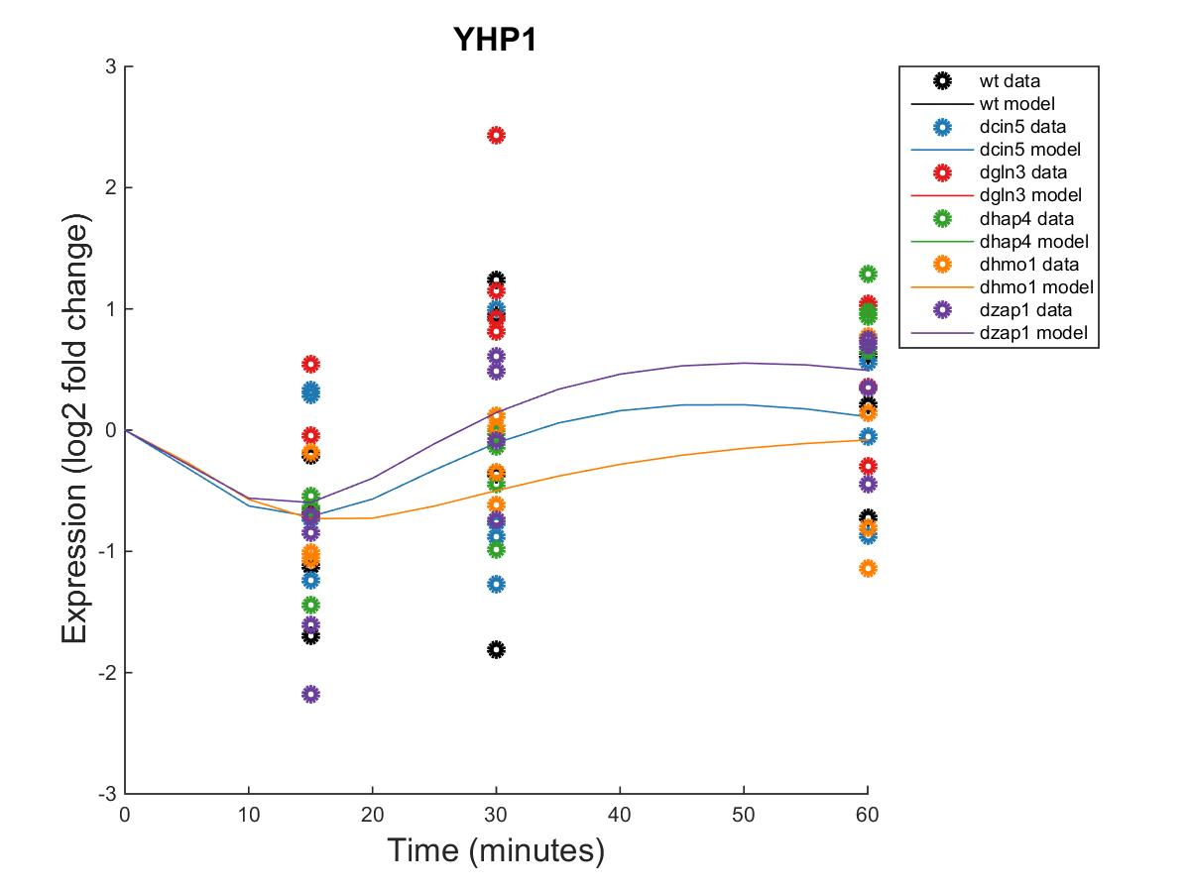
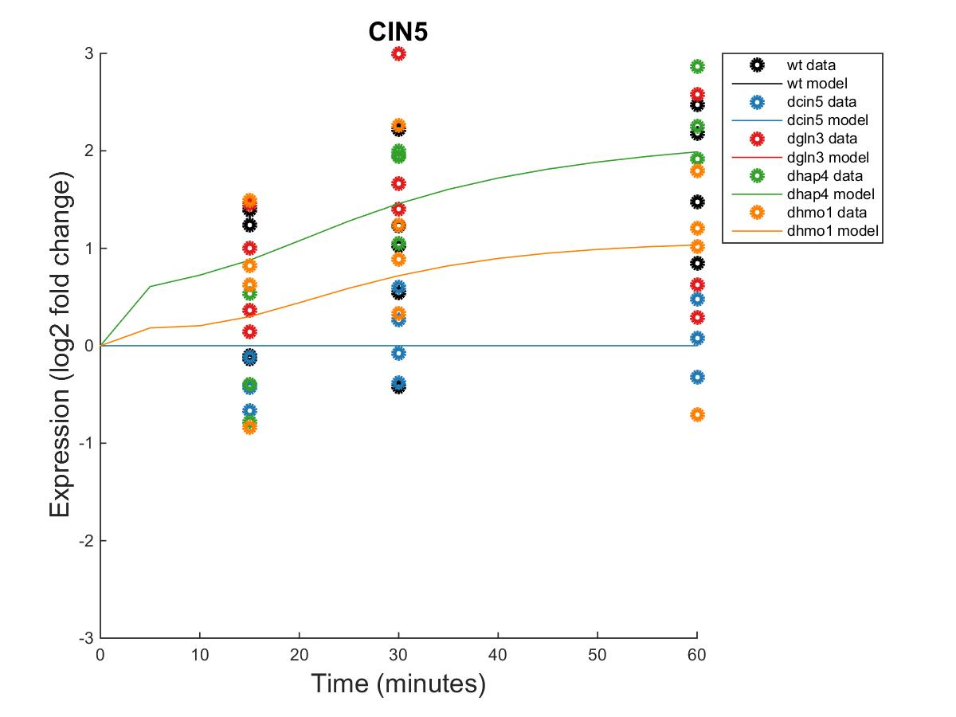

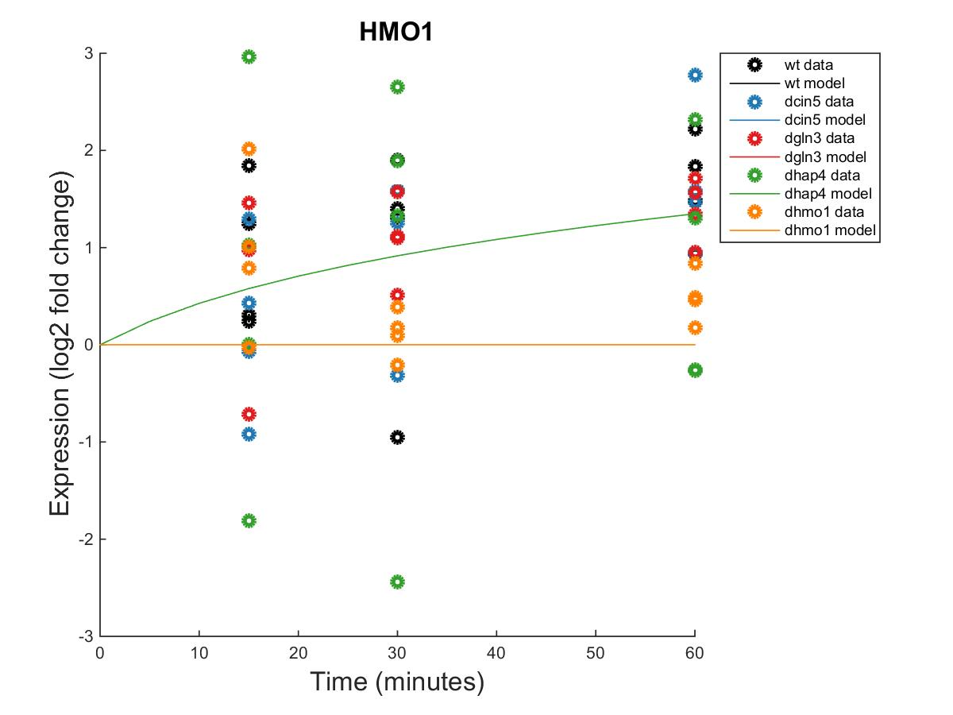

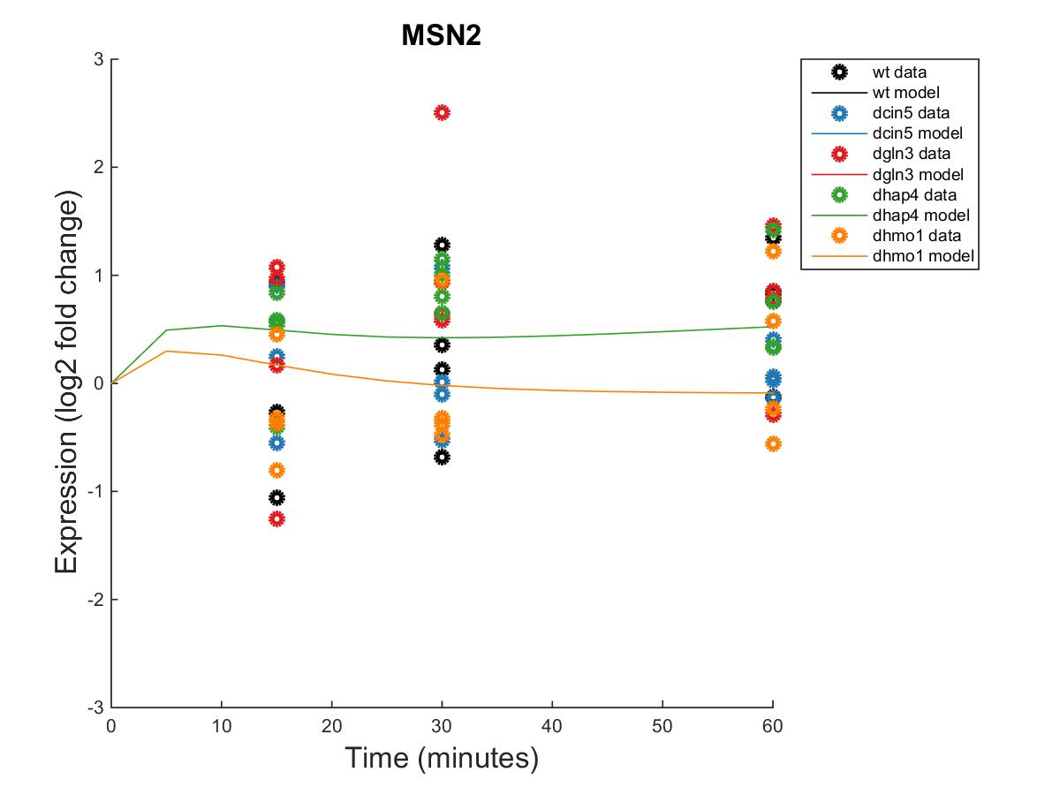
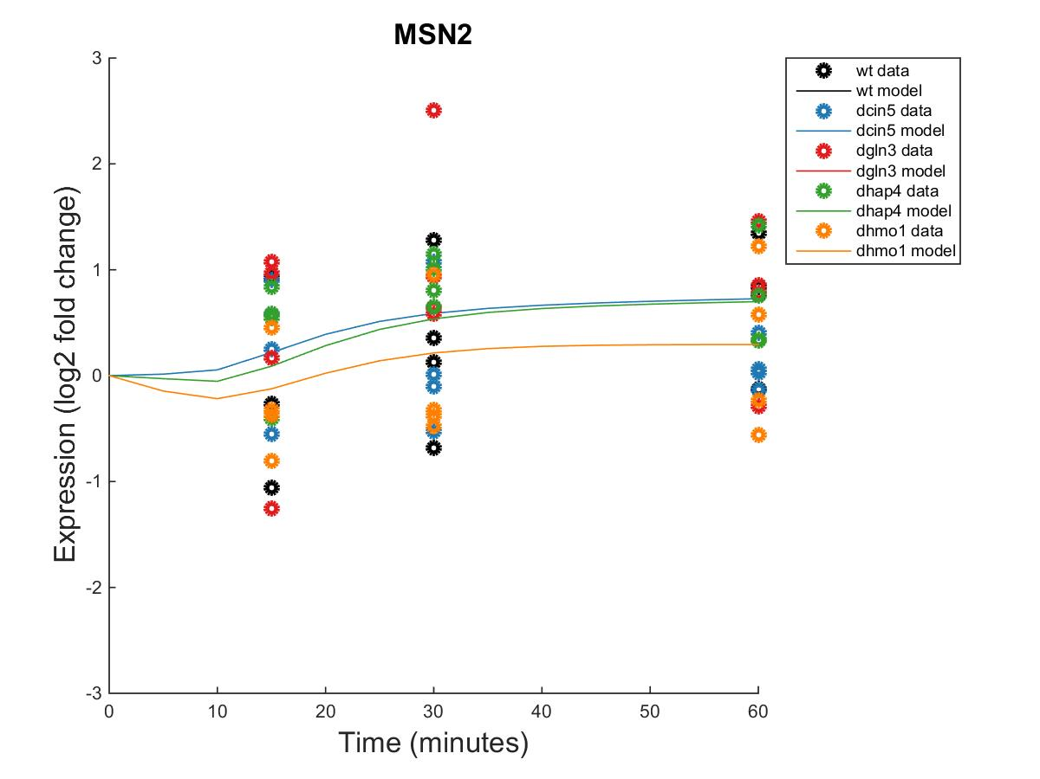
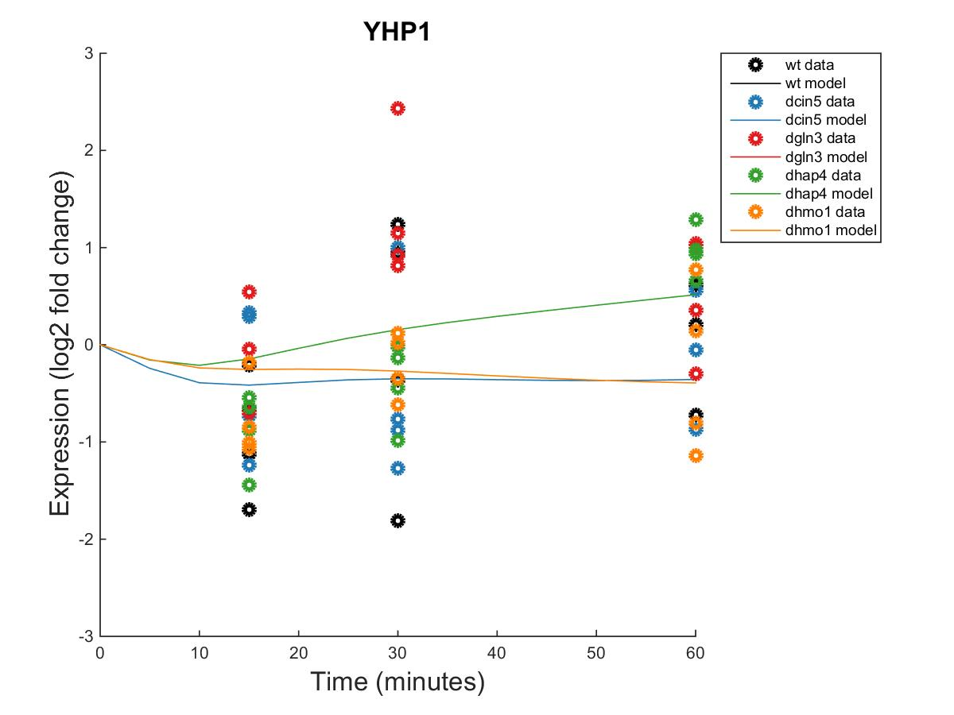
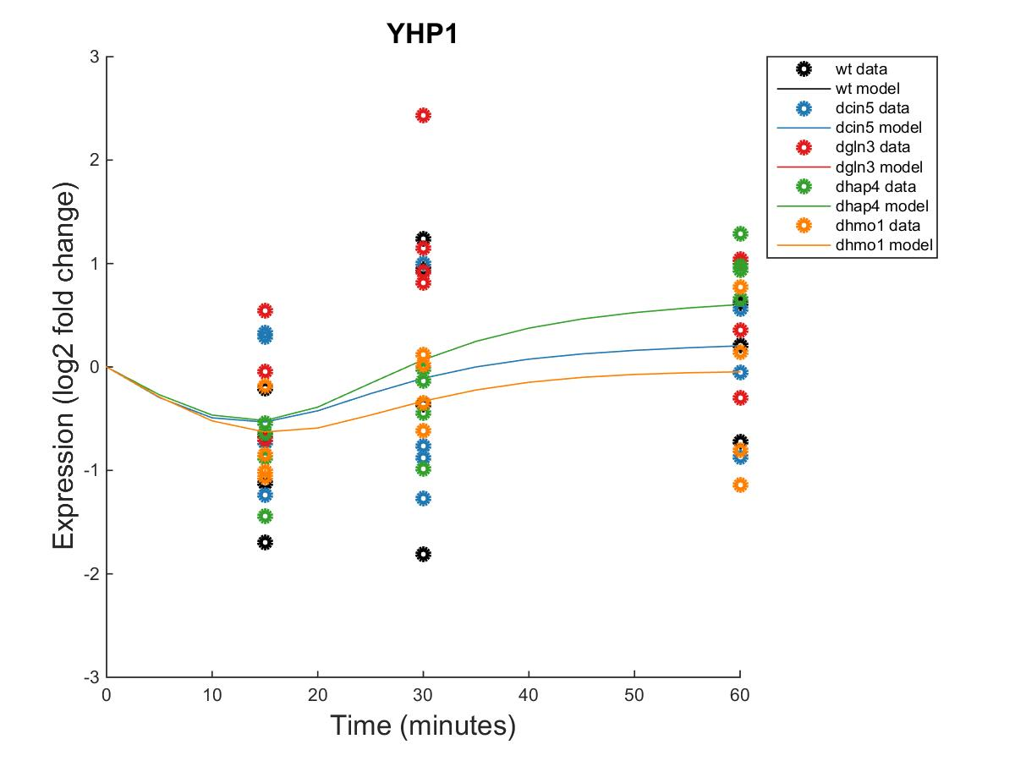


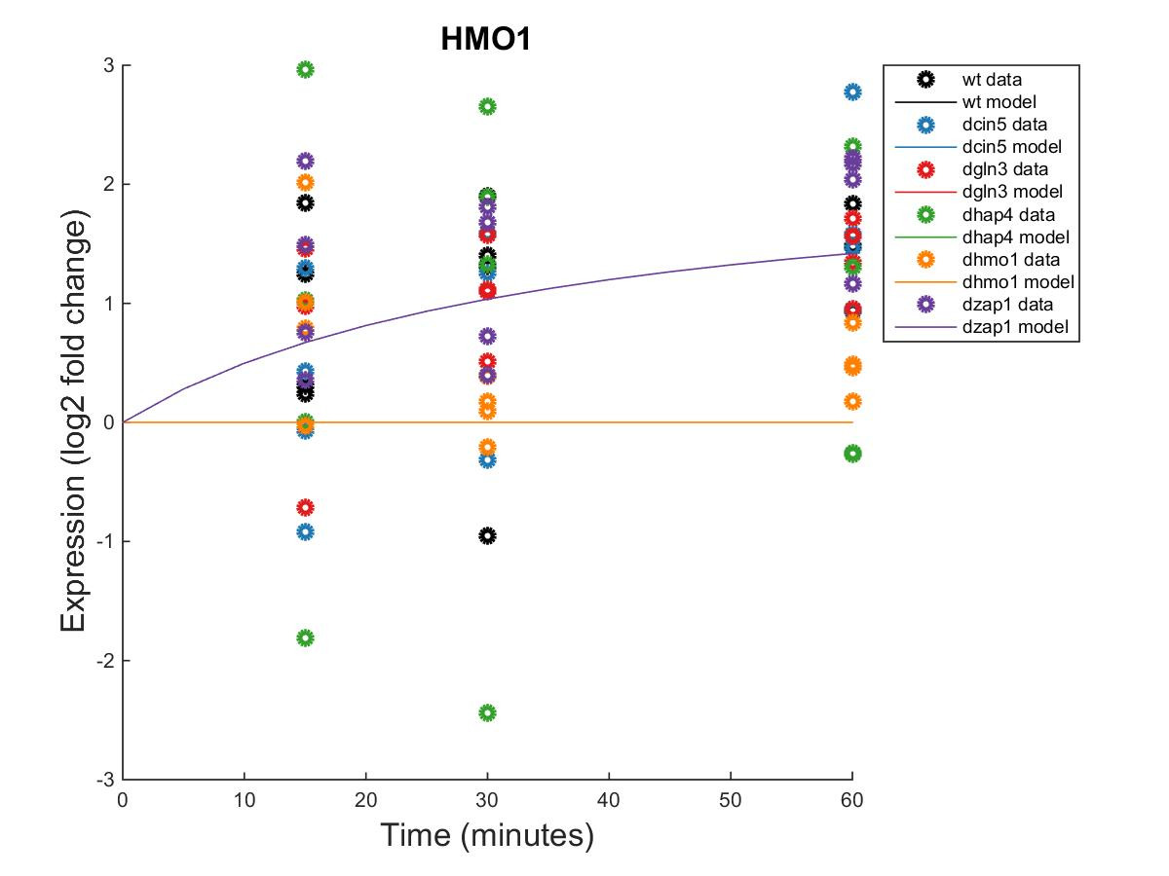
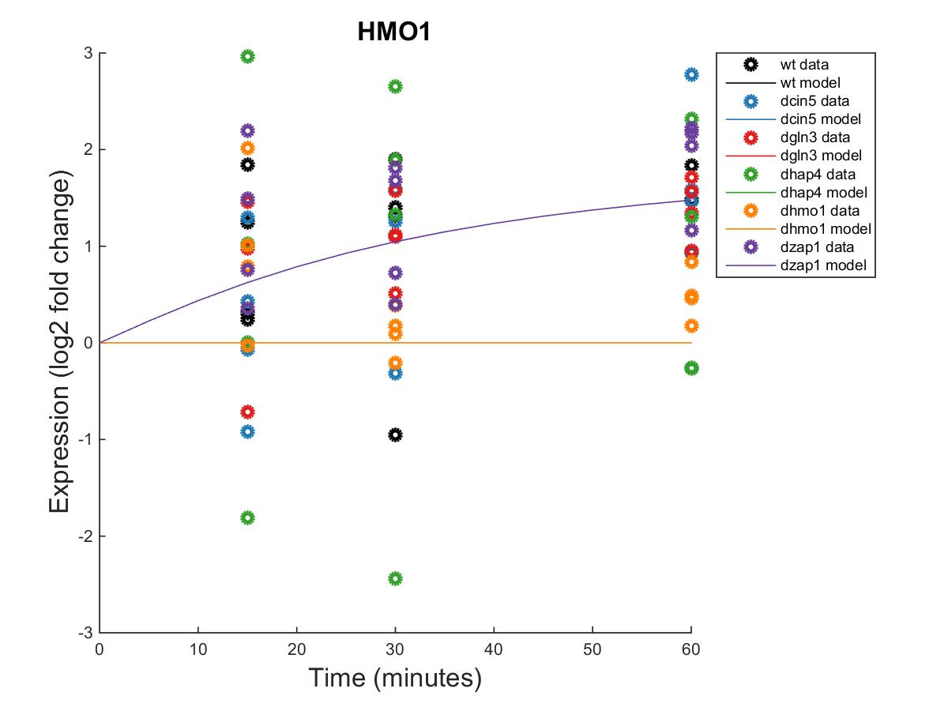
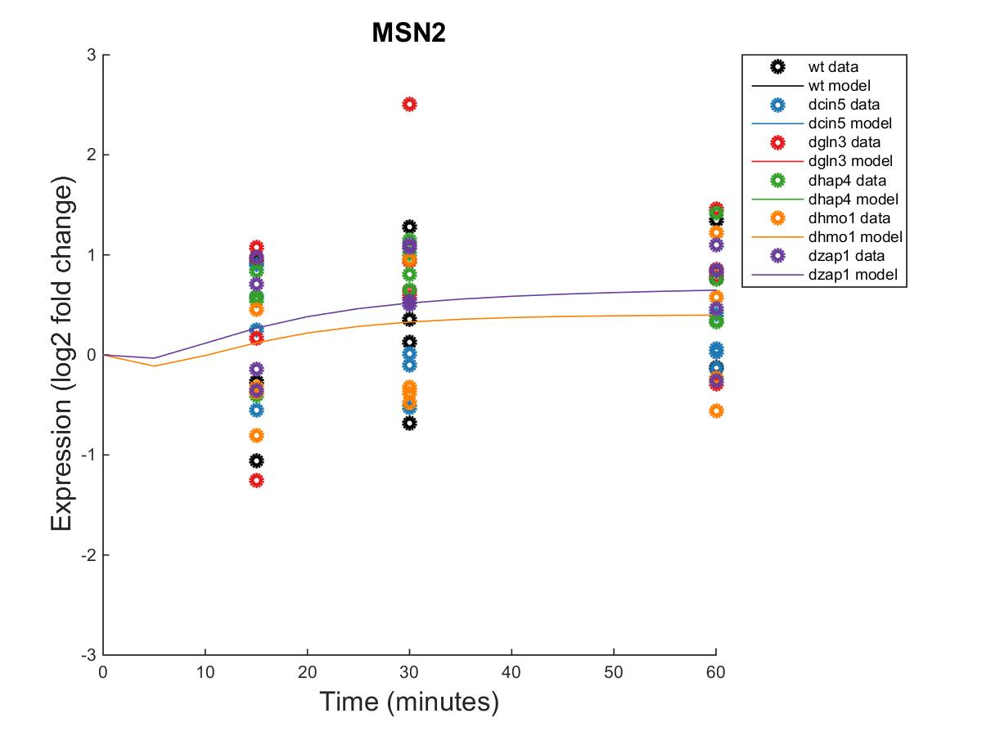
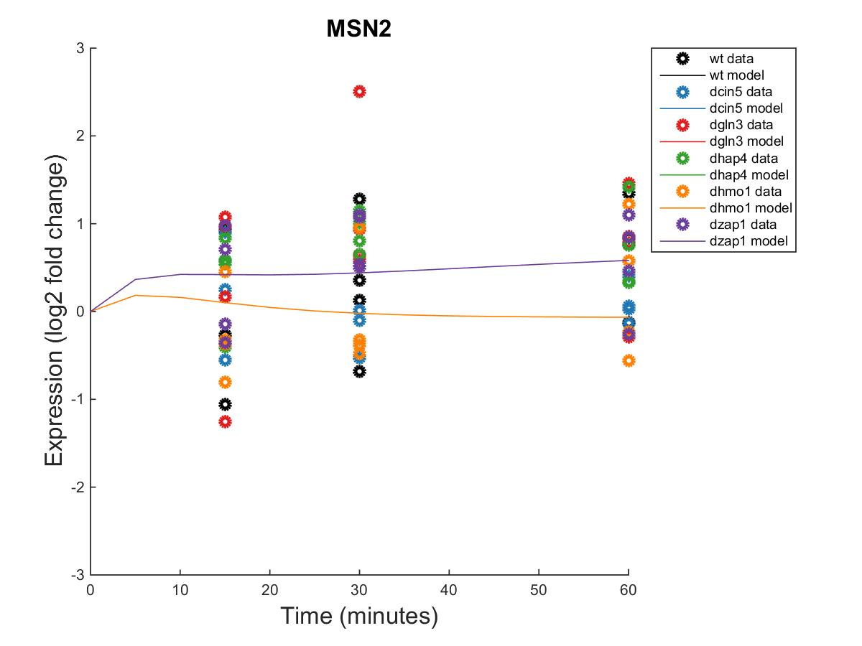
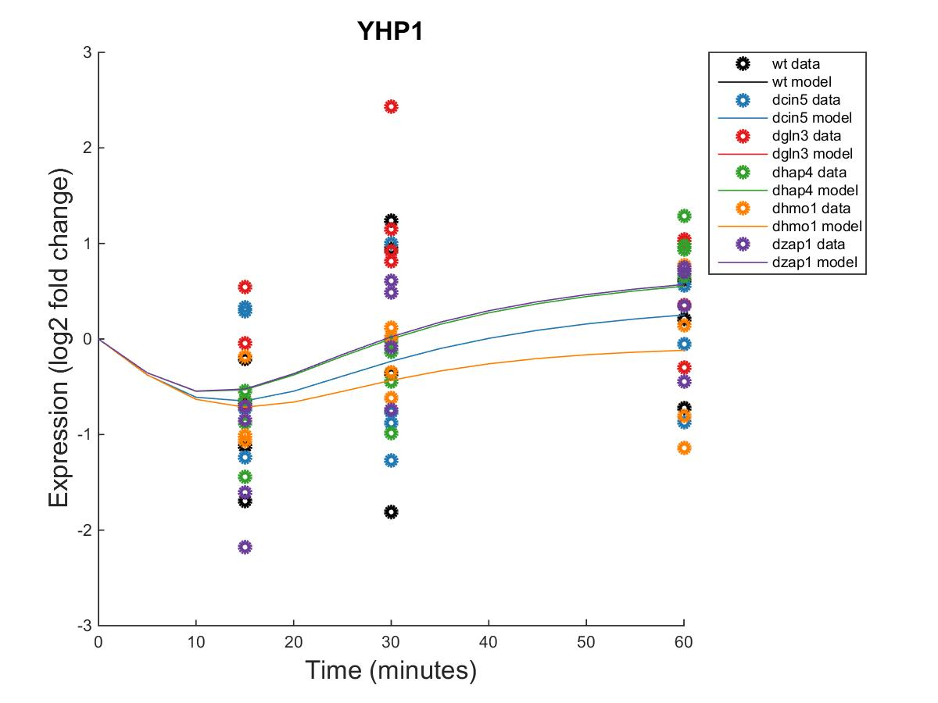
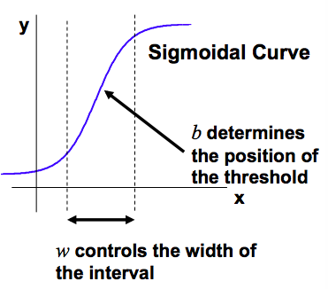
Dynamical systems modeling of six related small gene regulatory networks suggest that the transcription factors
Cin5, Hmo1, Msn2, and Yhp1 play a role in controlling the cold shock response in Saccharomyces cerevisiae
Natalie E. Williams¹, Brandon J. Klein¹, Kam D. Dahlquist¹, and Ben G. Fitzpatrick²
¹Department of Biology, ²Department of Mathematics
Loyola Marymount University, 1 LMU Drive, Los Angeles, CA 90045 USA
Transcription Factors Control Gene Expression by Binding to Regulatory DNA Sequences Upstream of Genes
Through Visualization of Six Weighted Networks, GRNsight Highlighted a Key Regulatory Motif Found in Five of the Six Databased-Derived GRNs
Activators increase gene expression.
Repressors decrease gene expression.
Transcription factors are themselves proteins that are encoded by genes.
A gene regulatory network (GRN) consists of a set of transcription factors that regulate the level of expression of a set of target genes, which can include other transcription factors.
The dynamics of a GRN is how the expression of genes in the network change over time.
1. Network derived from wt data
16 genes, 36 edges
2. Network derived from ∆cin5 data
14 genes, 25 edges
3. Network derived from ∆cin5 data
17 genes, 32 edges
4. Network derived from ∆gln3 data
14 genes, 35 edges
5. Network derived from ∆hap4 data
15 genes, 28 edges
6. Network derived from ∆zap1 data
16 genes, 27 edges
Yeast Respond to the Environmental Stress of Cold Shock
by Changing Gene Expression
Network | LSE:minLSE ratio
1 | 1.4206
2 | 1.3580
3 | 1.4100
4 | 1.3000
5 | 1.4263
6 | 1.3973
Average | 1.3854
Little is known about which transcription factors regulate this response.
The Dahlquist Lab studies the global transcriptional response to cold shock using DNA microarrays, which measure the level of mRNA expression for all 6000 yeast genes.
We have collected expression data from the wild type strain and five transcription factor deletion strains (Δcin5, Δgln3, Δhmo1, Δzap1, Δhap4 ) before cold shock at 30°C and after 15, 30, and 60 minutes of cold shock at 13°C.
We use mathematical modeling to determine the relative influence of each transcription factor in the GRN that controls the cold shock response.
GRNsight automatically generates weighted network graphs from the output produced by GRNmap.
The absolute value of the weight parameters are divided by the largest value, which distributes them between 0 and 1. Line thickness is on a linear scale with thin lines near 0 and thick lines near 1.
Positive weights are colored magenta to indicate activation; negative weights are colored cyan to indicate repression. Weights within 0.05 of zero are colored grey to denote negligible influence on the target gene.
Something about the motif
In the table, the ratio between the least squares error and the theoretical minimum least squares error values were computed. The closer the value is to one, the better GRNmap performed in modeling the GRN.
The Dynamics in the Expression Plots of Cin5, Msn2, Hmo1, and Yhp1, Genes with Corrected p Values <0.05, were Modeled Well by GRNmap
CIN5
HMO1
MSN2
YHP1
Within Strain ANOVA Benjamini and Hochberg Corrected p values
 | CIN5 | HMO1 | MSN2 | YHP1
Network 1 | 0.0662 | 0.0397 | 0.3056 | 0.1743
Network 2 & 3 | N/A | 0.0022 | 0.2208 | 0.8684
Network 4 | 0.0163 | 0.0025 | 0.3427 | 0.0433
Network 5 | 0.0112 | 0.4244 | 0.0168 | 0.8152
Network from ∆hmo1 data | 0.4113 | N/A | 0.8021 | 0.8152
Network 6 | 0.026 | 0.0011 | 0.0836 | 0.0653
Network 1
Network 2
Network 1
Network 2
Network 1
Network 2
Network 1
Network 2
Microarray at 60 minutes after cold shock
Network 3
Network 4
Network 3
Network 4
Network 3
Network 4
Network 3
Network 4
Genes with significant p values (<0.05) had better fit dynamics from the model.
Some of the expression plot profiles for Msn2 and Yhp1 appear similar while the dynamics of Cin5 and Hmo1 are modeled alike.
Patterns from these dynamics suggest a sequential response of these specific genes in the cell as a response to cold shock.
Microarray Data from the Dahlquist Lab Was Used to Derive
a Family of Related GRNs from the YEASTRACT Database
DNA microarray data ANOVA results for each of the six strains showed which log₂ fold level changes were significantly different from zero. The criteria for significance was a corrected Benjamini & Hochberg (B&H) p value < 0.05.
The genes with significant expression changes were submitted to the YEASTRACT database, which returned a list of transcription factors that could potentially regulate those target genes, in order of significance.
Transcription factors for which we had deletion strain microarray data were added to the list of the most significant regulators for each strain to generate the six GRNs.
Transcription factors and edges were removed from the GRN in a stepwise fashion in order of least to most significant until the network was pared down to have fewer than 20 genes.
Each of the pared-down GRNs were then input into the Dahlquist lab’s GRNmap program to model the dynamics of each gene’s expression in their respective networks.
Network 5
Network 6
Network 5
Network 6
Network 5
Network 6
Network 5
Strain | Wild-type | ∆cin5 | ∆gln3 | ∆hap4 | ∆zap1
Significant genes | 1936 (31%) | 1683 (28%) | 1683 (28%) | 1794 (29%) | 1859 (30%)
GRNmap fitted the Optimized Production Rates and Threshold_B Values for Each Individual Network, which Indicates Changes in Regulatory Patterns.
Conclusions and Future Directions
Optimized Production Rates
Optimized Threshold_B Values
From GRNsight visualization, a circuit involving the transcription factors Hmo1, Msn2, Cin5, and Yhp1 was identified. These genes mentioned regulate the progression of yeast’s cell cycle as a response to cold shock.
Hmo1 plays a role in genome maintenance by regulating transcription of RNAs. Msn2 is a known stress response gene. Cin5 is a leucine-zipper and guides TUP1, a stress response gene, to its targets. Finally, Yhp1 represses genes involved in M/G1 transition by binding to their promoter region, the early cell cycle box.
The LSE and the ratio of output LSE to theoretical minimum LSE for each networks demonstrated that the model works consistently for this range of network sizes.
The ∆hap4 15-gene 28-edge network derived from the YEASTRACT database was compared to 10 random networks of the same genes and same number of edges connected randomly. Comparison of output LSE:minLSE ratio, in general, showed the database-derived network was modeled better than the random networks.
Future directions include compiling more random networks with the same nodes and same number of edges. These will provide a control that will allow us to be more confident in the model interpretation and validity of our database-derived networks.
We would also like to compare GRNmap’s optimized production rates to published rates, giving us more confidence in the model’s capacity to generate parameters.
For Each Gene in the Network, a Nonlinear Differential Equation Determines the Rate at Which the Gene is Expressed
The model, called GRNmap (Gene Regulatory Network modeling and parameter estimation) was implemented in MATLAB (Dahlquist et al. 2015).
The MATLAB code and executable are available under an open source license at https://github.com/kdahlquist/GRNmap/.
Each gene has a differential equation that models the change in expression over time
Degradation rates for each gene were derived from the half lives reported by Neymotin et al. (2014)
We use a sigmoidal production function where:
P_{i} is mRNA production rate for gene i
d_{i} is the mRNA degradation rate for gene i
w is weight term, determining the level of activation or repression of j on i
b is a unique threshold for each gene
The production rate (P_{i} ), weight (w ), and threshold (b) values were estimated from DNA microarray data using a penalized least squares approach.
The threshold_b values indicate whether the repression or activation inputs are stronger.
For instance, MSN2 appears to be strongly repressed in both the networks derived from ∆cin5 data and ∆zap1 data, whereas it is strongly activated in the networks derived from wild-type, ∆gln3, and ∆hap4 data.
Comparison to 10 Random Networks Reveals Database-Derived Networks are Modeled Better
Least Squares Error of 10 Random 15-Gene 28-Edge Networks
Acknowledgments
For their work on the GRNmap code, we would like to thank Trixie Anne M. Roque, Chukwuemeka E. Azinge, and Justin K. Torres. We thank Nicole A. Anguiano, Anindita Varshneya, Mihir Samdarshi, Edward Bachuora, Jen Shin, and Eileen Choe for their work on the GRNsight visualization software. Microarray data were collected by Cybele Arsan, Wesley Citti, Kevin Entzminger, Andrew Herman, Monica Hong, Heather King, Lauren Kubeck, Stephanie Kuelbs, Elizabeth Liu, Matthew Mejia, Kevin McGee, Kenny Rodriguez, Olivia Sakhon, Alondra Vega, and Kevin Wyllie. Further, we would like to thank Kristen M. Horstmann and Margaret J. O’Neil for their contributions to the GRNmap data analysis team. This work was supported by NSF-RUI Award 0921038 (K.D.D., B.G.F.), a Kadner-Pitts Research Grant (K.D.D.), and a Loyola Marymount University Honors Program Summer Fellowship (K.G.J.).
References
Abdulrehman, D., Monteiro, P., Teixeira, M., Mira, N., Lourenço, A., Santos, S., Cabrito, T., Francisco, A., Madeira, S., Aires, R., Oliveira, A., Sá-Correia, I., & Freitas, A. (2011). YEASTRACT: providing a programmatic access to curated transcriptional regulatory associations in Saccharomyces cerevisiae through a web services interface Nucl. Acids Res., 39: D136-D140, Oxford University Press.
Dahlquist, K., Fitzpatrick, B., Camacho, E., Entzminger, S., & Wanner, N. (2015). Parameter Estimation for Gene Regulatory Networks from Microarray Data: Cold Shock Response in Saccharomyces cerevisiae. Bulletin Of Mathematical Biology, 77(8), 1457-1492. http://dx.doi.org/10.1007/s11538-015-0092-6.
Dahlquist, K., Dionisio, J.D., Fitzpatrick, B., Anguiano, N., Varshneya, A., Southwick, B., and Sardarshi, M. (2016). GRNsight: a web application and service for visualizing models of small- to medium-scale gene regulatory networks. PeerJ Computer Science, 2:e85 from http://doi.org/10.7717/peerj-cs.85
GRNsight - Home. (n.d.). Retrieved March 10, 2016, from http://dondi.github.io/GRNsight/.
GRNmap – Home.. (n.d.). Retrieved March 10, 2016, from https://github.com/kdahlquist/GRNmap
Neymotin, B., Athanasiadou R., and Gresham D. (2014). Determination of in vivo RNA kinetics using RATE-seq. RNA, 20, 1645-1652.
E represents the error between estimated values and microarray data values.
θ is the penalty term, which is the combined w, P, and b parameter values.
Random networks to compare to the YEASTRACT-derived network from ∆hap4 data were created from the same 15 genes, but with 28 random connections.
Random networks allow for a control against which to compare the performance of the YEASTRACT-derived network.
The ratios of Least Squares Error to the minimum Least Squares Error were generally higher for the random networks than the database-derived network.
Both trends indicate that the database-derived network is modeled better by GRNmap than the random networks, although further analysis is needed.

